Slide 1
Chapter 6: MAC Protocols for Ad-Hoc Wireless Networks
Introduction
Issues
Design Goals
Classifications
Contention-based Protocols
Contention-based Protocols with reservation mechanisms
Contention-based Protocols without Scheduling mechanisms
MAC Protocols that use directional antennas
Other MAC Protocols

Slide 2
Issues
The main issues need to be addressed while designing a MAC protocol for ad hoc wireless networks:
Bandwidth efficiency is defined at the ratio of the bandwidth used for actual data transmission to the total available bandwidth. The MAC protocol for ad-hoc networks should maximize it.
Quality of service support is essential for time-critical applications. The MAC protocol for ad-hoc networks should consider the constraint of ad-hoc networks.
Synchronization can be achieved by exchange of control packets.

Slide 3
Issues
The main issues need to be addressed while designing a MAC protocol for ad hoc wireless networks:
Hidden and exposed terminal problems:
Hidden nodes:
Hidden stations: Carrier sensing may fail to detect another station. For example, A and D.
Fading: The strength of radio signals diminished rapidly with the distance from the transmitter. For example, A and C.
Exposed nodes:
Exposed stations: B is sending to A. C can detect it. C might want to send to E but conclude it cannot transmit because C hears B.
Collision masking: The local signal might drown out the remote transmission.
Error-Prone Shared Broadcast Channel
Distributed Nature/Lack of Central Coordination
Mobility of Nodes: Nodes are mobile most of the time.

Slide 4
A significant difference between wired and wireless LANs is the fact that, in general a fully connected topology between the WLAN nodes cannot b assumed. This problem gives rise to ‘hidden’ and ‘exposed’ station problems.
Hidden Terminal:
As seen in the above problem, the transmission range of A reaches B but not C. Similarly, the range of C reaches B but not A. Also the range of B reaches both A and C.
Now, the node A starts to send something to B and C doesn’t receive this transmission.
Now C also wants to send data to B and senses the carrier. As it senses it to be free, it also starts sending to B.
Hidden terminal problem occurs when two nodes that are outside each other’s range performs simultaneous transmission to a node that is within the range of each of them resulting in a collision.
That means the data from both parties A and C will be lost during the collision.
Hidden nodes mean increased probability of collision at receiver end.
One solution to avoid this is to have the channel sensing range much greater than the receiving range. Another solution is to use the Multiple Access with Collision Avoidance (MACA).

Slide 5
Exposed Terminal:
Consider the same above diagram. Here imagine a situation wherein the B node is currently sending some data to node A.
Now the other node C which is right now free want to send data to some node D(not in diag) which is outside the range of A and B.
Now before starting transmission it senses the carrier and realizes that the carrier is busy (due to interference of B’s signal).
Hence, the C node postpones the transmission to D until it detects the medium to be idle.
However such a wait was un-necessary as A was outside the interference range of C.
Also a collision at B will be a weak enough to be unable to penetrate into C
Exposed terminal problem occurs when the node is within the range of a node that is transmitting and it cannot be transmitted to any node.
Exposed node means denied channel access unnecessarily which ultimately results in under-utilization of bandwidth resources.
It also results in wastage of time-resource.

Slide 6
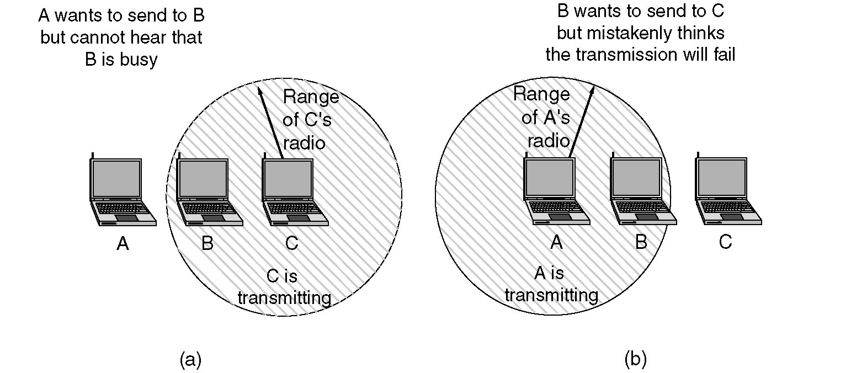
The 802.11 MAC Sublayer Protocol
(a) The hidden station problem.
(b) The exposed station problem.

Slide 7
Design goals of a MAC Protocol
Design goals of a MAC protocol for ad hoc wireless networks
The operation of the protocol should be distributed.
The protocol should provide QoS support for real-time traffic.
The access delay, which refers to the average delay experienced by any packet to get transmitted, must be kept low.
The available bandwidth must be utilized efficiently.
The protocol should ensure fair allocation of bandwidth to nodes.
Control overhead must be kept as low as possible.
The protocol should minimize the effects of hidden and exposed terminal problems.
The protocol must be scalable to large networks.
It should have power control mechanisms.
The protocol should have mechanisms for adaptive data rate control.
It should try to use directional antennas.
The protocol should provide synchronization among nodes.

Slide 8
Classifications of MAC protocols
Ad hoc network MAC protocols can be classified into three types:
Contention-based protocols
Contention-based protocols with reservation mechanisms
Contention-based protocols with scheduling mechanisms
Other MAC protocols
MAC Protocols for Ad Hoc
Wireless Networks
Contention-Based
Protocols
Contention-based
protocols with
reservation mechanisms
Contention-based
protocols with
scheduling mechanisms
Other MAC
Protocols
RI-BTMA
DirectionalAntennas
Sender-Initiated
Protocols
Receiver-Initiated
Protocols
Synchronous
Protocols
Asynchronous
Protocols
MACA-BI
MMAC
MARCH
RI-BTMA
D-PRMA
MCSMA
MACA/PR
PCM
Single-Channel
Protocols
Multichannel
Protocols
MACA-BI
CATA
RTMAC
MARCH
HRMA
RBAR
MACAW
BTMA
SRMA/PA
FAMA
DBTMA
FPRP
ICSMA

Slide 9
Classifications of MAC Protocols
Contention-based protocols
Sender-initiated protocols: Packet transmissions are initiated by the sender node.
Single-channel sender-initiated protocols: A node that wins the contention to the channel can make use of the entire bandwidth.
Multichannel sender-initiated protocols: The available bandwidth is divided into multiple channels.
Receiver-initiated protocols: The receiver node initiates the contention resolution protocol.
Contention-based protocols with reservation mechanisms
Synchronous protocols: All nodes need to be synchronized. Global time synchronization is difficult to achieve.
Asynchronous protocols: These protocols use relative time information for effecting reservations.

Slide 10
Classifications of MAC Protocols
Contention-based protocols with scheduling mechanisms
Node scheduling is done in a manner so that all nodes are treated fairly and no node is starved of bandwidth.
Scheduling-based schemes are also used for enforcing priorities among flows whose packets are queued at nodes.
Some scheduling schemes also consider battery characteristics.
Other protocols are those MAC protocols that do not strictly fall under the above categories.

Slide 11
Contention-based protocols
MACAW: A Media Access Protocol for Wireless LANs is based on MACA (Multiple Access Collision Avoidance) Protocol
MACA
When a node wants to transmit a data packet, it first transmit a RTS (Request To Send) frame.
The receiver node, on receiving the RTS packet, if it is ready to receive the data packet, transmits a CTS (Clear to Send) packet.
Once the sender receives the CTS packet without any error, it starts transmitting the data packet.
If a packet transmitted by a node is lost, the node uses the binary exponential back-off (BEB) algorithm to back off a random interval of time before retrying.
The binary exponential back-off mechanism used in MACA might starves flows sometimes. The problem is solved by MACAW.

Slide 12
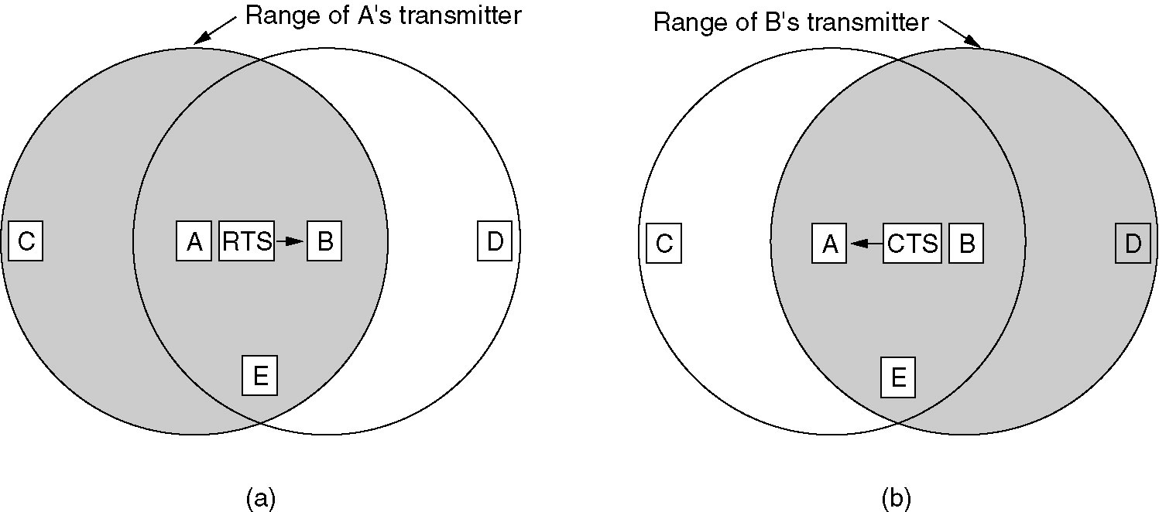
MACA Protocol
The MACA protocol. (a) A sending an RTS to B.
(b) B responding with a CTS to A.

Slide 13
MACA examples
MACA avoids the problem of hidden terminals
A and C want to send to B
A sends RTS first
C waits after receiving CTS from B
MACA avoids the problem of exposed terminals
B wants to send to A, C to another terminal
now C does not have to wait for it cannot receive CTS from A
RTS
CTS
CTS
A
B
C
RTS
RTS
CTS
A
B
C

Slide 14
MACAW
Variants of this method can be found in IEEE 802.11 as DFWMAC (Distributed Foundation Wireless MAC),
MACAW (MACA for Wireless) is a revision of MACA.
The sender senses the carrier to see and transmits a RTS (Request To Send) frame if no nearby station transmits a RTS.
The receiver replies with a CTS (Clear To Send) frame.
Neighbors
see CTS, then keep quiet.
see RTS but not CTS, then keep quiet until the CTS is back to the sender.
BEB is modified
1. Header has backoff counter which is copied by Rx node ino its backoff counter
2, Multiplicative increase and Additive decrease
3. Per flow fairness as compared to per node fairness

Slide 15
The receiver sends an ACK when receiving an frame.
Neighbors keep silent until see ACK.
Uses DS packets to avoid exposed terminal problem

Slide 16
MACA variant: DFWMAC in IEEE802.11
sender
receiver
idle
idle
packet ready to send; RTS
data;
ACK
RxBusy
time-out;
RTS
wait for the
right to send
RTS;
CTS
time-out ∨
data;
NAK
ACK
time-out ∨
NAK;
RTS
CTS; data
wait for ACK
wait for
data
ACK: positive acknowledgement
NAK: negative acknowledgement
RxBusy: receiver busy
RTS; RxBusy

Slide 17
Contention-based protocols
Floor acquisition Multiple Access Protocols (FAMA)
Based on a channel access discipline which consists of a carrier-sensing operation and a collision-avoidance dialog between the sender and the intended receiver of a packet.
Floor acquisition refers to the process of gaining control of the channel. At any time only one node is assigned to use the channel.
Carrier-sensing by the sender, followed by the RTS-CTS control packet exchange, enables the protocol to perform as efficiently as MACA.
Two variations of FAMA
RTS-CTS exchange with no carrier-sensing uses the ALOHA protocol for transmitting RTS packets.
RTS-CTS exchange with non-persistent carrier-sensing uses non-persistent CSMA for the same purpose.

Slide 18
Contention-based protocols
Busy Tone Multiple Access Protocols (BTMA)
The transmission channel is split into two:
a data channel for data packet transmissions
a control channel used to transmit the busy tone signal
When a node is ready for transmission, it senses the channel to check whether the busy tone is active.
If not, it turns on the busy tone signal and starts data transmissions
Otherwise, it reschedules the packet for transmission after some random rescheduling delay.
Any other node which senses the carrier on the incoming data channel also transmits the busy tone signal on the control channel, thus, prevent two neighboring nodes from transmitting at the same time.
Dual Busy Tone Multiple Access Protocol (DBTMAP) is an extension of the BTMA scheme.
a data channel for data packet transmissions
a control channel used for control packet transmissions (RTS and CTS packets) and also for transmitting the busy tones.

Slide 19
Contention-based protocols
Receiver-Initiated Busy Tone Multiple Access Protocol (RI-BTMA)
The transmission channel is split into two:
a data channel for data packet transmissions
a control channel used for transmitting the busy tone signal
A node can transmit on the data channel only if it finds the busy tone to be absent on the control channel.
The data packet is divided into two portions: a preamble and the actual data packet.
MACA-By Invitation (MACA-BI) is a receiver-initiated MAC protocol.
By eliminating the need for the RTS packet it reduces the number of control packets used in the MACA protocol which uses the three-way handshake mechanism.
Media Access with Reduced Handshake (MARCH) is a receiver-initiated protocol.

Slide 20
Contention-based Protocols with Reservation Mechanisms
Contention-based Protocols with Reservation Mechanisms
Contention occurs during the resource (bandwidth) reservation phase.
Once the bandwidth is reserved, the node gets exclusive access to the reserved bandwidth.
QoS support can be provided for real-time traffic.
Distributed packet reservation multiple access protocol (D-PRMA)
It extends the centralized packet reservation multiple access (PRMA) scheme into a distributed scheme that can be used in ad hoc wireless networks.
PRMA was designed in a wireless LAN with a base station.
D-PRMA extends PRMA protocol in a wireless LAN.
D-PRMA is a TDMA-based scheme. The channel is divided into fixed- and equal-sized frames along the time axis.

Slide 21
Access method DAMA: Reservation-TDMA
Reservation Time Division Multiple Access
every frame consists of N mini-slots and x data-slots
every station has its own mini-slot and can reserve up to k data-slots using this mini-slot (i.e. x = N * k).
other stations can send data in unused data-slots according to a round-robin sending scheme (best-effort traffic)
e.g. N=6, k=2
N mini-slots
N * k data-slots
reservations for data-slots
other stations can use free data-slots
based on a round-robin scheme
Notes:
26

Slide 22
Distributed Packet Reservation Multiple Access Protocol (D-PRMA)
Implicit reservation (PRMA - Packet Reservation Multiple Access):
a certain number of slots form a frame, frames are repeated
stations compete for empty slots according to the slotted aloha principle
once a station reserves a slot successfully, this slot is automatically assigned to this station in all following frames as long as the station has data to send
competition for this slots starts again as soon as the slot was empty in the last frame
reservation
1
2
3
4
5
6
7
8
time-slot
ACDABA-F
frame₁
A
C
D
A
B
A
F
ACDABA-F
frame₂
A
C
A
B
A
AC-ABAF-
frame₃
A
B
A
F
collision at reservation attempts
A---BAFD
frame₄
A
B
A
F
D
ACEEBAFD
frame₅
A
C
E
E
B
A
F
D
t
Notes:
25

Slide 23
Contention-based protocols with Reservation Mechanisms
Collision avoidance time allocation protocol (CATA)
based on dynamic topology-dependent transmission scheduling
Nodes contend for and reserve time slots by means of a distributed reservation and handshake mechanism.
Support broadcast, unicast, and multicast transmissions.
The operation is based on two basic principles:
The receiver(s) of a flow must inform the potential source nodes about the reserved slot on which it is currently receiving packets. The source node must inform the potential destination node(s) about interferences in the slot.
Usage of negative acknowledgements for reservation requests, and control packet transmissions at the beginning of each slot, for distributing slot reservation information to senders of broadcast or multicast sessions.

Slide 24
Contention-based protocols with Reservation Mechanisms
Hop reservation multiple access protocol (HRMA)
a multichannel MAC protocol which is based on half-duplex, very slow frequency-hopping spread spectrum (FHSS) radios
uses a reservation and handshake mechanism to enable a pair of communicating nodes to reserve a frequency hop, thereby guaranteeing collision-free data transmission.
can be viewed as a time slot reservation protocol where each time slot is assigned a separate frequency channel.
Soft reservation multiple access with priority assignment (SRMA/PA)
Developed with the main objective of supporting integrated services of real-time and non-real-time application in ad hoc networks, at the same time maximizing the statistical multiplexing gain.
Nodes use a collision-avoidance handshake mechanism and a soft reservation mechanism.

Slide 25
Contention-based protocols with Reservation Mechanisms
Five-Phase Reservation Protocol (FPRP)
a single-channel time division multiple access (TDMA)-based broadcast scheduling protocol.
Nodes uses a contention mechanism in order to acquire time slots.
The protocol assumes the availability of global time at all nodes.
The reservation takes five phases: reservation, collision report, reservation confirmation, reservation acknowledgement, and packing and elimination phase.
MACA with Piggy-Backed Reservation (MACA/PR)
Provide real-time traffic support in multi-hop wireless networks
Based on the MACAW protocol with non-persistent CSMA
The main components of MACA/PR are:
A MAC protocol
A reservation protocol
A QoS routing protocol

Slide 26
Contention-based protocols with Reservation Mechanisms
Real-Time Medium Access Control Protocol (RTMAC)
Provides a bandwidth reservation mechanism for supporting real-time traffic in ad hoc wireless networks
RTMAC has two components
A MAC layer protocol is a real-time extension of the IEEE 802.11 DCF.
A medium-access protocol for best-effort traffic
A reservation protocol for real-time traffic
A QoS routing protocol is responsible for end-to-end reservation and release of bandwidth resources.

Slide 27
Contention-based protocols with Scheduling Mechanisms
Protocols in this category focus on packet scheduling at the nodes and transmission scheduling of the nodes.
The factors that affects scheduling decisions
Delay targets of packets
Traffic load at nodes
Battery power
Distributed priority scheduling and medium access in Ad Hoc Networks present two mechanisms for providing quality of service (QoS)
Distributed priority scheduling (DPS) – piggy-backs the priority tag of a node’s current and head-of-line packets o the control and data packets
Multi-hop coordination – extends the DPS scheme to carry out scheduling over multi-hop paths.

Slide 28
Contention-based protocols with Scheduling Mechanisms
Distributed Wireless Ordering Protocol (DWOP)
A media access scheme along with a scheduling mechanism
Based on the distributed priority scheduling scheme
Distributed Laxity-based Priority Scheduling (DLPS) Scheme
Scheduling decisions are made based on
The states of neighboring nodes and feed back from destination nodes regarding packet losses
Packets are recorded based on their uniform laxity budgets (ULBs) and the packet delivery ratios of the flows. The laxity of a packet is the time remaining before its deadline.

Slide 29
MAC Protocols that use directional Antennas
MAC protocols that use directional antennas have several advantages:
Reduce signal interference
Increase in the system throughput
Improved channel reuse
MAC protocol using directional antennas
Make use of an RTS/CTS exchange mechanism
Use directional antennas for transmitting and receiving data packets
Directional Busy Tone-based MAC Protocol (DBTMA)
It uses directional antennas for transmitting the RTS, CTS, data frames, and the busy tones.
Directional MAC Protocols for Ad Hoc Wireless Networks
DMAC-1, a directional antenna is used for transmitting RTS packets and omni-directional antenna for CTS packets.
DMAC-1, both directional RTS and omni-directional RTS transmission are used.

Slide 30
Other MAC Protocols
Multi-channel MAC Protocol (MMAC)
Multiple channels for data transmission
There is no dedicated control channel.
Based on channel usage channels can be classified into three types: high preference channel (HIGH), medium preference channel (MID), low preference channel (LOW)
Multi-channel CSMA MAC Protocol (MCSMA)
The available bandwidth is divided into several channels
Power Control MAC Protocol (PCM) for Ad Hoc Networks
Allows nodes to vary their transmission power levels on a per-packet basis
Receiver-based Autorate Protocol (RBAR)
Use a rate adaptation approach
Interleaved Carrier-Sense Multiple Access Protocol (ICSMA)
The available bandwidth is split into tow equal channels
The handshaking process is interleaved between the two channels.

